Slide 1
HOTEL BOOKING SYSTEM

Slide 2
summary
Hotel Booking System, this project provides hotel management Web APIs which are built using ASP.NET Core framework.
It provides endpoints for user registration, authentication, and managing and booking hotel rooms.
The API supports CRUD operations different entities and allows users to interact with data.

Slide 3

Secure endpoints using JWT.
User registration and login (authentication and
authorization).
Role-based access control (Admin, guest)
CRUD operations for managing User, city, hotel, room, booking, payment. Validation on different entties.
FEATURES

Slide 4
Architecture & DESIGN PATTERNS
Onion Architecture
Repository Design Pattern

Slide 5

WEB API : Asp.Net Core database access : entityframework core. authentication : jwt library Validation rules : fluent api password encryption : cryptography Mapping: automapper Logging : serilog
FRAMEWORK & LIBRARIES :-

Slide 6
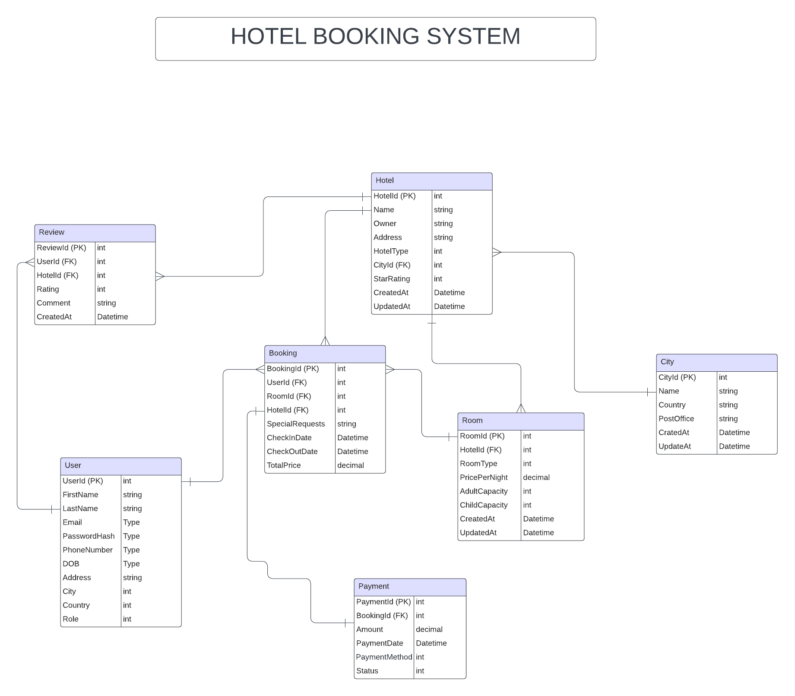
Database schema

Slide 7
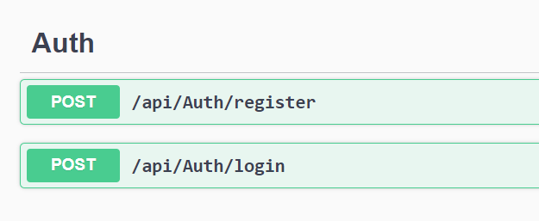
Auth apis

Slide 8
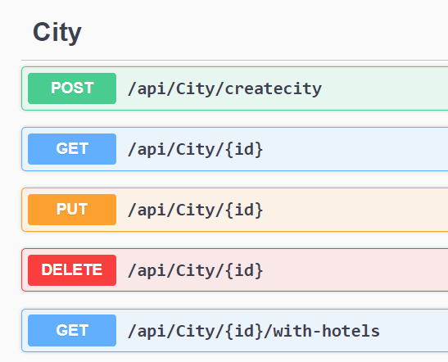
city apis

Slide 9
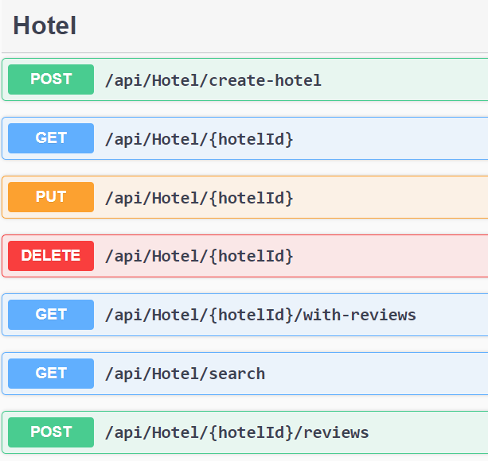
Hotel apis

Slide 10
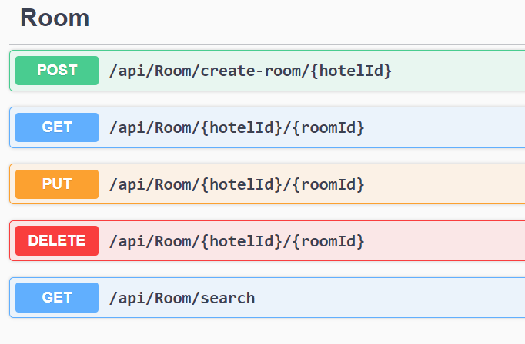
Room APIs

Slide 11
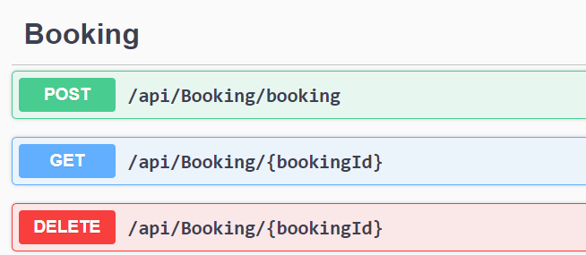
booking apis

Slide 12
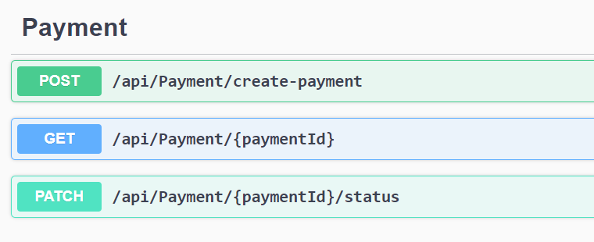
PAYMENT APIs

Slide 13
Thank you
Manisha Joshi

